Slide 1


General introduction, concepts and definitions of the GloboDiet methodology
INTERNATIONAL AGENCY FOR RESEARCH ON CANCER LYON - FRANCE
e-SMP

Slide 2

Historical background and perspectives
GloboDiet General Standardization Concepts
GloboDiet training:
IARC, Lyon - France
Concepts & definitions

Slide 3


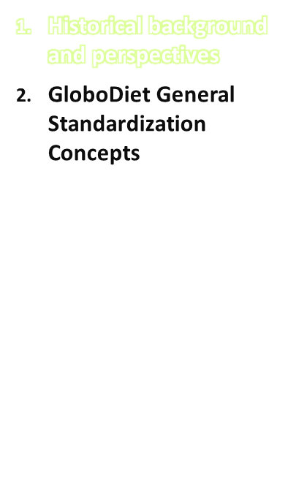
Why the 24-HR as the preferred reference method in international studies?
Open-ended & detailed nature (as compared to FFQ)
Higher participation rate because of lower respondent burden (no need for literacy, possibility to interview subjects face-to-face or by telephone)
Better standardization of the interview procedures within and between countries & within and between interviewers
→ computerized approach
Better standardization within and between respondents (subjects‘ specific bias), when using an open-ended method
→ interviewer-based approach
Can dietary data collected from open-ended methods be
properly standardized without an interviewer-
and computerized program assistance?
GloboDiet training:
IARC, Lyon - France
Concepts & definitions

Slide 4
What are the main methodological challenges?
Different languages and socio-cultural habits
Different dietary and meal patterns (e.g. foods, recipes, average portion, food consumption occasions, locations of consumption, etc…)
Different perception, understanding of diet and acceptability of dietary methodologies within and between countries and population groups (e.g. adults vs. children)
Different nature and magnitude of the dietary measurement errors (incl. within- and between individual bias)
Different geographical location, available infrastructures and nutritional skills of the interviewers
GloboDiet training:
IARC, Lyon - France
Concepts & definitions

Slide 5
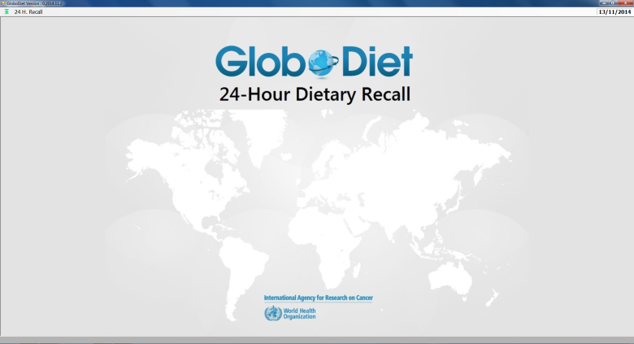
A common methodology for measuring
& monitoring accurately diet across Europe
Highly standardised and detailed 24-HDR method across EU countries (18 versions)
Same general concept and user’s interface
Adapted version for children and potentially elderly people (Data entry system)
Comprehensive quality controls (before, during and after interview collection)
Validated for face-to-face and telephone interview alternatives
Tested in different study designs & populations
Standardised e-training facilities (ongoing)
GloboDiet training:
IARC, Lyon - France
Concepts & definitions
Notes:
In its broad definition, GloboDiet is a Highly standardised and detailed 24-HDR method across EU countries
Same general concept and user’s interface
Adapted version for children and potentially elderly people (Data entry system)
Comprehensive quality controls (before, during and after interview collection)
Validated for face-to-face and telephone interview alternatives
Tested in different study designs & populations
Standardised e-training facilities (ongoing)
Several dozens of papers on the concept, validation, first set of comparable data available in Europe.

Slide 6
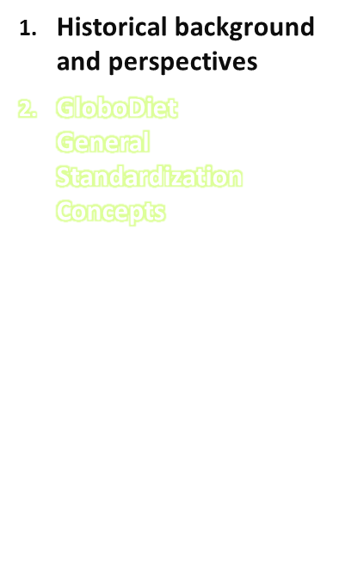
What does standardization of a dietary assessment method mean?
Prevent or minimize measurement errors
If errors are unavoidable, ensure that the errors are applied with about an equal magnitude within and between subjects and populations (non-differential error)
GloboDiet training:
IARC, Lyon - France
Concepts & definitions
Notes:
The general definition of the standardization principal aim of the standardization is to prevent or minimize measurement errors which can affect the estimation and comparison of dietary intakes between cohorts. However, when as it is the case for dietary assessment methods, there is no gold reference method totally free of errors and that therefore the errors are not totally avoidable, the standardization should the biases to be applied with about an equal magnitude in the different study populations. In practical terms this means developing an approach which assures that the same procedure to collect and subsequently manage and analyse the data is about the same everywhere.
It is therefore crucial to have a good understanding on the main dominant
errors which might be associated to the dietary measurements.

Slide 7
Error model of the 24-HDR measurements
24-HDR interview
ask questions
Interviewer
Respondent
answer questions
Food reporting
Food identification
Food quantification
omission
Com-
mission
mis-
identification
incomplete identification
over-
estimation
under-
estimation
missing quantity
under-
estim.
over-
estim.
Un-
predictable
Un-
predictable
over-
estim.
under-
estim.
under-
estim.
Net measurement errors (unpredictable)
GloboDiet training:
IARC, Lyon - France
Concepts & definitions

Slide 8
GloboDiet standardization concept to prevent errors
Computerized 24-h recall → standardized procedures to be followed by all interviewers (to minimize differences in interviewing between dieticians)
Stepwise approach:
  First brief overview of foods/drinks consumed the day before (Quick list)
  Secondly in depth description and quantification
  Quality controls built in in software
Question (facet) – Answer options (descriptors) system
Extra tools available to optimize portion size estimations (e.g. photo book, bread shapes, etc.)
GloboDiet training:
IARC, Lyon - France
Concepts & definitions

Slide 9
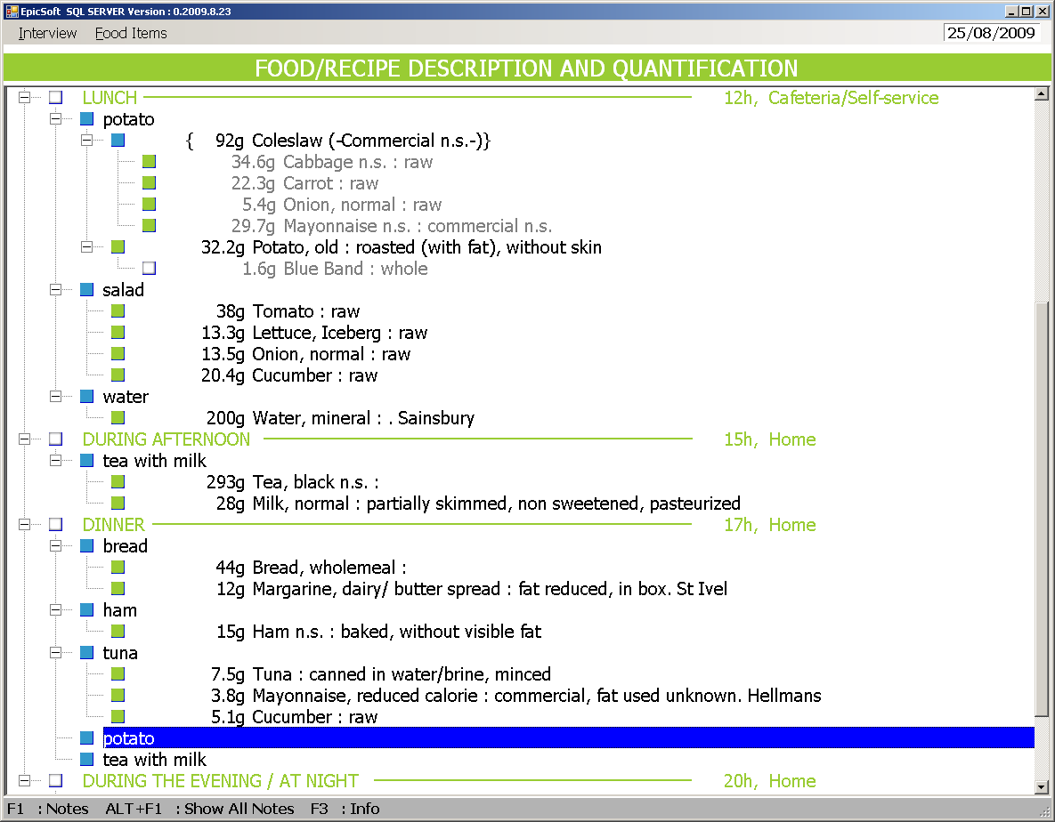
GloboDiet: A standardised and flexible system
GloboDiet training:
IARC, Lyon - France
Concepts & definitions
Notes:
GD is a standardised tool which
- share the same interface and general concept across country-versions and standardised procedures to collect, search, describe, quantify, probe, calculate, export and maintain 24-Hdr recalls within and between countries.
- all the detailed information is systematically collected, stored and entirely retrievable
- As an example, the identification, search and level of description of the foods consumed by the study subjects is controlled by using the same sets of questions (facets such as preservation method, physical state, cooking method, skin consumed) and their related precoded answers of descriptors (e.g. different baked, fried, etc…) specific to each facet

Slide 10
GloboDiet: A standardised and flexible system
GloboDiet training:
IARC, Lyon - France
Concepts & definitions
Notes:
GD is a standardised tool which
- share the same interface and general concept across country-versions and standardised procedures to collect, search, describe, quantify, probe, calculate, export and maintain 24-Hdr recalls within and between countries.
- all the detailed information is systematically collected, stored and entirely retrievable
- As an example, the identification, search and level of description of the foods consumed by the study subjects is controlled by using the same sets of questions (facets such as preservation method, physical state, cooking method, skin consumed) and their related precoded answers of descriptors (e.g. different baked, fried, etc…) specific to each facet

Slide 11
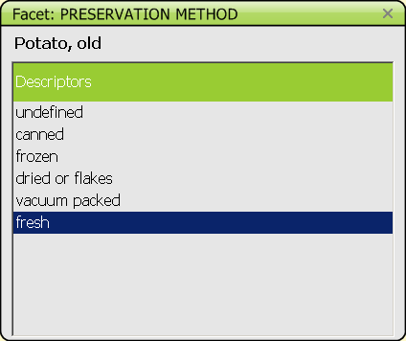
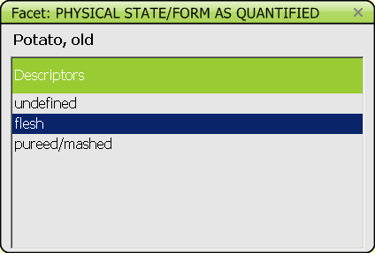
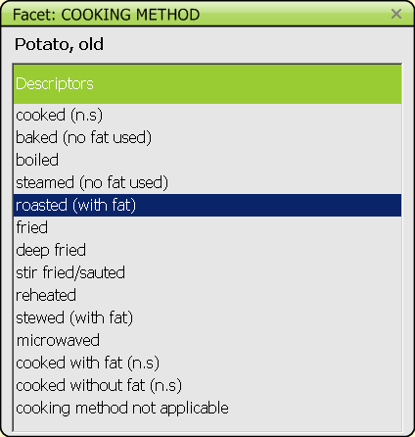
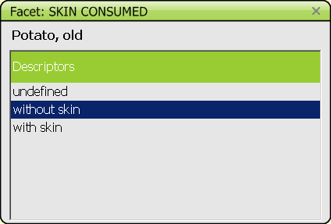
GloboDiet: A standardised and flexible system
GloboDiet training:
IARC, Lyon - France
Concepts & definitions
Notes:
GD is a standardised tool which
- share the same interface and general concept across country-versions and standardised procedures to collect, search, describe, quantify, probe, calculate, export and maintain 24-Hdr recalls within and between countries.
- all the detailed information is systematically collected, stored and entirely retrievable
- As an example, the identification, search and level of description of the foods consumed by the study subjects is controlled by using the same sets of questions (facets such as preservation method, physical state, cooking method, skin consumed) and their related precoded answers of descriptors (e.g. different baked, fried, etc…) specific to each facet

Slide 12
GloboDiet: A standardised and flexible system
GloboDiet training:
IARC, Lyon - France
Concepts & definitions
Notes:
GD is a standardised tool which
- share the same interface and general concept across country-versions and standardised procedures to collect, search, describe, quantify, probe, calculate, export and maintain 24-Hdr recalls within and between countries.
- all the detailed information is systematically collected, stored and entirely retrievable
- As an example, the identification, search and level of description of the foods consumed by the study subjects is controlled by using the same sets of questions (facets such as preservation method, physical state, cooking method, skin consumed) and their related precoded answers of descriptors (e.g. different baked, fried, etc…) specific to each facet

Slide 13
GloboDiet: A standardised and flexible system
Possibility to add:
New food
New recipe
New facet
New descriptor
GloboDiet training:
IARC, Lyon - France
Concepts & definitions
Notes:
GD is a standardised tool which
- share the same interface and general concept across country-versions and standardised procedures to collect, search, describe, quantify, probe, calculate, export and maintain 24-Hdr recalls within and between countries.
- all the detailed information is systematically collected, stored and entirely retrievable
- As an example, the identification, search and level of description of the foods consumed by the study subjects is controlled by using the same sets of questions (facets such as preservation method, physical state, cooking method, skin consumed) and their related precoded answers of descriptors (e.g. different baked, fried, etc…) specific to each facet

Slide 14
GloboDiet: Overall internal structure
Two main pathways
Selected Quick List Item
Food Pathway
Mixed Recipe
Pathway
Automatic search
Searching in the food list
Searching in the recipe list
GloboDiet training:
IARC, Lyon - France
Concepts & definitions

Slide 15
Training is essential to ensure the standardization concepts
GloboDiet itself already prevents many sources of error (see previous slides)
However, an in depth GloboDiet training for the trainers and local coordinators/dieticians is crucial to optimize the standardization procedures foreseen in GloboDiet
It is important that all materials provided during the training (manual, slides, etc.) are translated to the local language without changing its contents to guarantee the concept of standardization!
GloboDiet training:
IARC, Lyon - France
Concepts & definitions

